Slide 1
To Shoot an Elephant
Storyboard by: Kody Everson

Slide 2
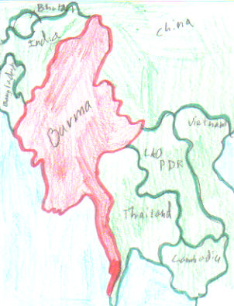
Shot #1
Action Description:
A map of where the story takes place
Framing: Establishing shot
Angle: High Angle
Dialogue / Narration:
N/A
Editing Techniques / Camera Movements:
Fade-out
Lighting:
High Key
Music / Sound:
Cultural Music

Slide 3
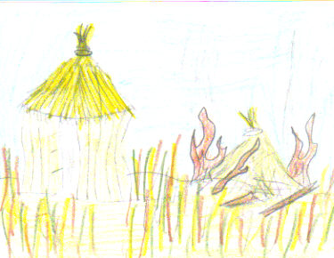
Shot #2
Action Description:
You see a destroyed city
Framing: Establishing Shot
Angle: Eye Level
Dialogue / Narration:
Crying and screaming
Editing Techniques / Camera Movements:
Pan
Lighting: High Key
Music / Sound:
N/A

Slide 4
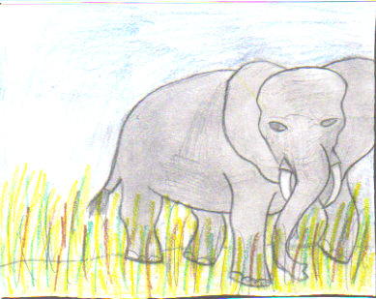
Shot #3
Action Description:
You see a running Elephant
Framing: Long Shot
Angle: Eye Level
Dialogue / Narration:
N/A
Editing Techniques / Camera Movements:
Dolly/Tracking and Shot-Reverse-Shot
Lighting: High Key
Music / Sound:
Elephant Noises

Slide 5
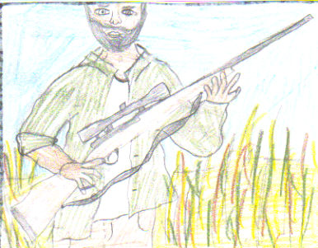
Shot #4
Action Description: The main Character grabs a gun and gets ready to chase the Elephant
Framing: Medium Shot
Angle: Low angle
Dialogue / Narration:
N/A
Editing Techniques / Camera Movements:
Shot-Reverse-Shot
Lighting: High Key
Music / Sound:
Dramatic

Slide 6
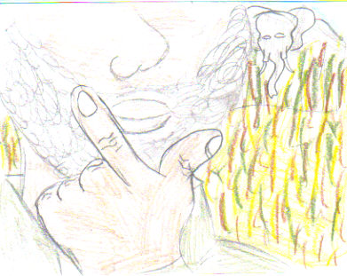
Shot #5
Action Description: The main character decides whether or not to shoot the Elephant
Framing: Close-up(hand)
Angle: Eye level
Dialogue / Narration:
You would hear his thoughts
Editing Techniques / Camera Movements: Zoom
Lighting: High Key
Music / Sound:
N/A

Slide 7
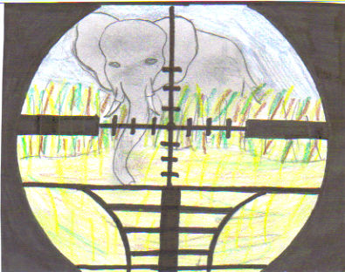
Shot #6
Action Description: The main character is getting ready to shoot the Elephant
Framing: Close-up (Elephant)
Angle: Eye Level
Dialogue / Narration: Right before he shoots he says “Gatcha yah”
Editing Techniques / Camera Movements: Tilt
Lighting: High Key
Music / Sound:
N/A

Slide 8
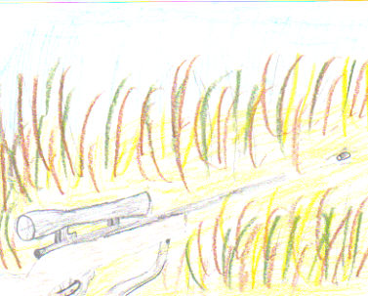
Shot #7
Action Description: You see the main character pull the trigger and you see the bullet fly out
Framing: Close-up (gun)
Angle: High Angle
Dialogue / Narration:
N/A
Editing Techniques / Camera Movements:
Tilt ( it follows bullet)
Lighting: High Key
Music / Sound:
Gun Shot

Slide 9
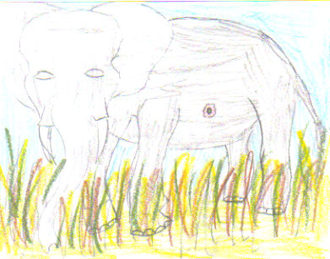
Shot #8
Action Description: You see the Elephant get shot
Framing: Long Shot
Angle: Low Angle
Dialogue / Narration:
N/A
Editing Techniques / Camera Movements: Fade-out as Elephant falls
Lighting: High Key
Music / Sound: Elephant Noise

Slide 10
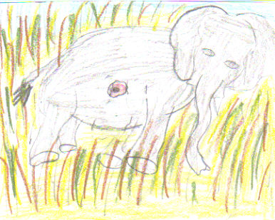
Shot #9
Action Description: You see the Elephant lying on the ground
Framing: Long Shot
Angle: High Angle
Dialogue / Narration:
N/A
Editing Techniques / Camera Movements: Zooms towards head
Lighting: High Key
Music / Sound: Elephant in Pain

Slide 11
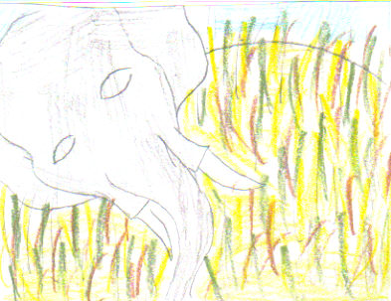
Shot #10
Action Description: Up close to Elephants head to see its pain and suffering
Framing: Close-up (Elephant’s Head)
Angle: High Angle
Dialogue / Narration:
N/A
Editing Techniques / Camera Movements: Zoom towards Eye then fades to black
Lighting: High Key
Music / Sound:
Elephant Noise

