Slide 1
Graphic Novel Presentation
By: Sarah Gjerdrum

Slide 2
Framing
Long Shot
Medium Shot
Extreme Closeup
Close-Up

Slide 3
Lighting
High Key Lighting
Low Key Lighting
Neutral Lighting

Slide 4
Angles
Low Angle
High Angle
Eye-level

Slide 5
The Call to Adventure
The Call to adventure in my novel is represented by the King asking Michael to go out on an adventure to save his daughter, Princess Anna.

Slide 6
The Refusal of the Call
The Refusal of the Call is shown by Michael running away into the forest and hiding in the tree trunk. He does not want to go on the adventure, so he escapes the castle.

Slide 7
The Beginning of the Adventure
The beginning of the adventure is very simple in my story. Michael is found by the King and the King gives him his horse and he leaves from there.

Slide 8
The Road of Trials
In my graphic novel, the Road of Trials is when the three shadows who kidnapped Anna set up obstacles in the forest for Michael and Jim the horse to have to overcome.

Slide 9
The Experience with Unconditional Love
In my story, Anna and Michael are the ones who fall in love just like the princess in all of the other hero stories fall in love with the knight.

Slide 10
The Ultimate Boon
The Ultimate Boon is achieved in my story when Michael finds Anna held prisoner inside a rotting log. He rescues her, which was the whole point of going on the journey.

Slide 11
The Magic Flight
Once Michael and Anna are together Michael signals the King’s dragon, and he comes and flies them home back to the castle in the kingdom. That is how the Magic Flight is represented in my graphic novel.

Slide 12
The Return Threshold
The Return Threshold is shown by Michael being thanked by the King for rescuing his daughter from the scary black shadows.

Slide 13
The Archetypical Hero
My hero follows the lines of an archetypical hero because he goes through eight of the ten stages presented in our Springboard books.

Slide 14
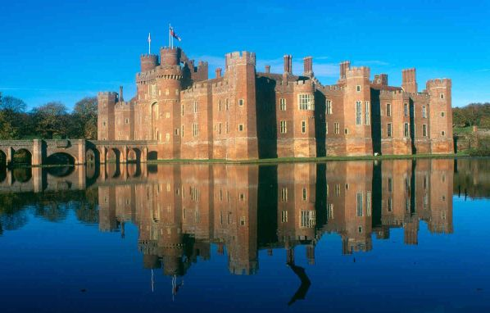
Thanks for Watching.

