Slide 1
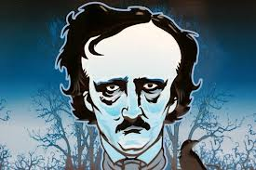
How is Edgar Allan Poe’s THEME still conveyed in a different genre and time period?
How are his themes relevant still today?

