Slide 1
Storyboards

Slide 2
Storyboards
Allow filmmakers to plan the details of the film, shot by shot, in advance, saving time and money.
Makes a visual of sketches of a film-to-be.
Describes dialogue, camera shots, angles, lighting, music/sound, camera movement, and editing techniques.

Slide 3
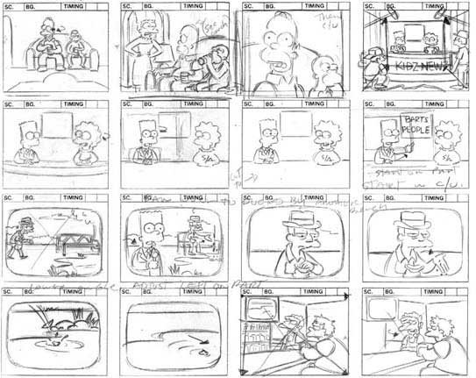

Slide 5
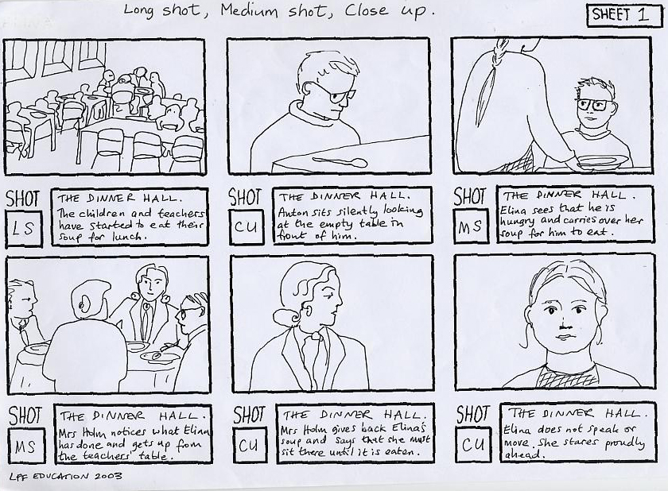

Slide 6
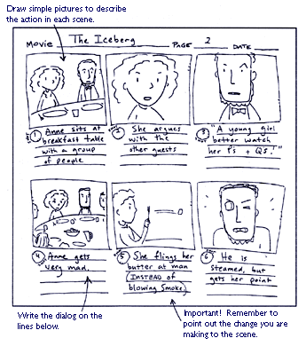

Slide 7
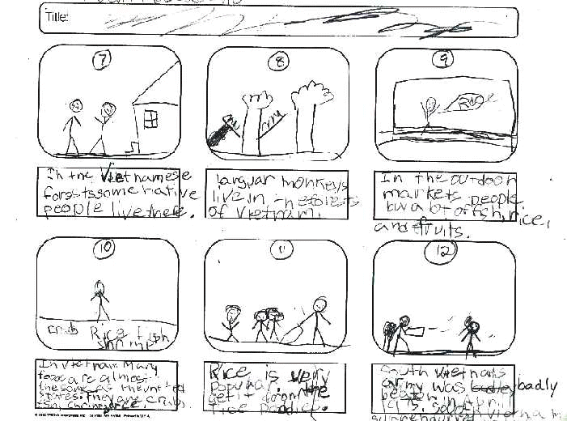
Bad Example

