Slide 1
Marigolds
By: Ann Marie Anderson

Slide 2
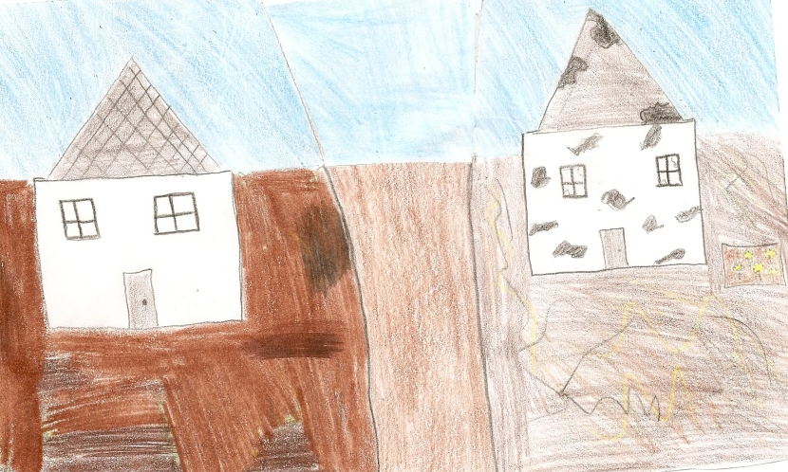
Shot one
Description/Action: Showing the dirt road, with a single patch of marigolds
Framing: Establishing Shot
Angle: Eye Level
Music/Sound: Non-Diegetic; Sad/ Neutral
Dialogue/Narration: None
Editing techniques: Fade
Camera Movements: Panning
Lighting: Low Key

Slide 3
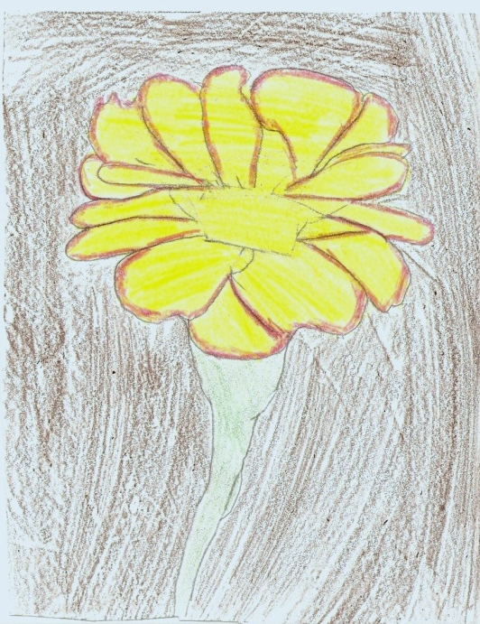
Shot two
Description/Action: Focusing in on a single Marigold
Framing: Close Up
Angle: Eye Level
Music/Sound: Non- Diegetic; Gets happier, to more of a neutral sound
Dialogue/Narration: None
Editing techniques: Dissolve
Camera Movements: Zoom
Lighting: High Key

Slide 4
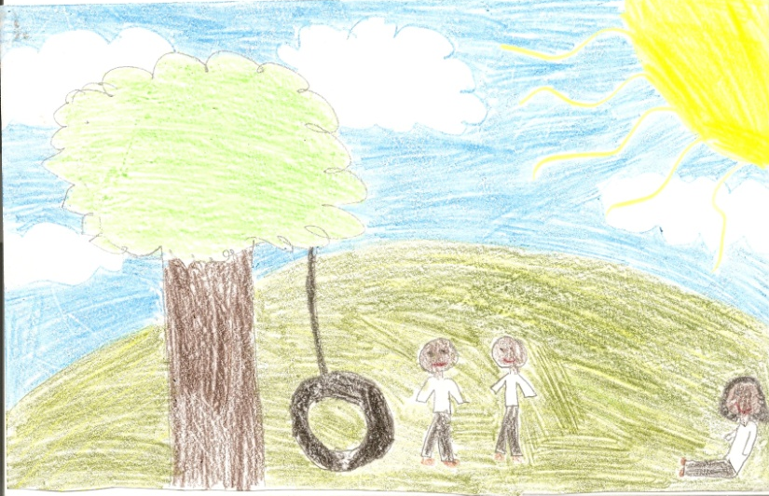
Shot three
Description/Action: Kids are playing, then start talking
Framing: Long Shot
Angle: Eye Level
Music/Sound: None
Dialogue/Narration: Boys ask what they are going to do, then they decide to go to Miss Lottie’s
Editing techniques: Cut
Camera Movements: Zoom in when characters talk to each other
Lighting: High Key

Slide 5
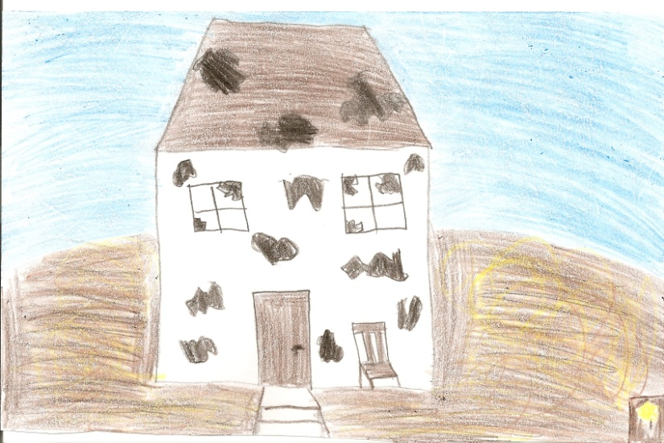
Shot four
Description/Action: Showing Miss Lottie’s property
Framing: Establishing Shot
Angle: Eye Level
Music/Sound: Suspenseful/Fast
Dialogue/Narration: None
Editing techniques: Wipe
Camera Movements: Panning
Lighting: Low Key

Slide 6
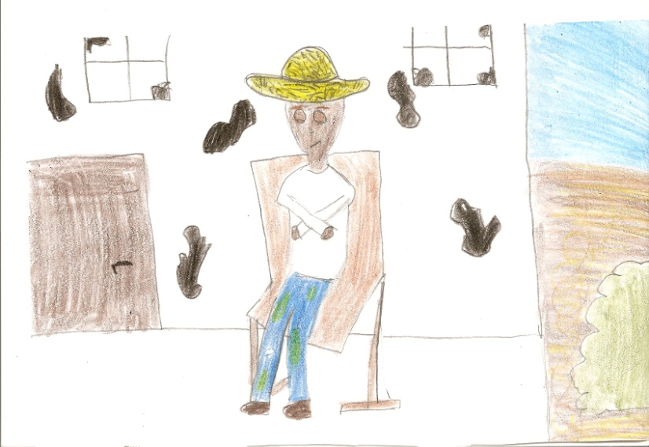
Shot five
Description/Action: Showing John Burke
Framing: Long Shot
Angle: Eye level
Music/Sound: Non-Diegetic; fast/suspenseful
Dialogue/Narration: None
Editing techniques: Cut
Camera Movements: Zoom in on John
Lighting: Low Key

Slide 7
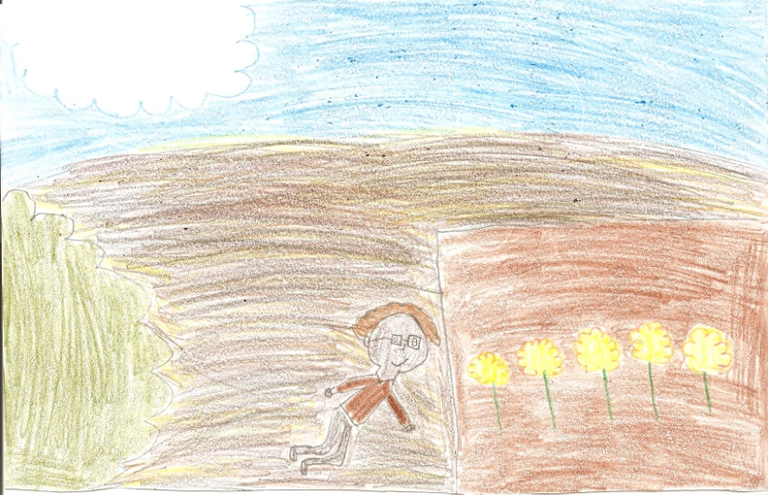
Shot six
Description/Action: Shows Miss Lottie attending to her Marigolds
Framing: Long Shot
Angle: Eye Level
Music/Sound: Non-Diegetic; Slow and peaceful
Dialogue/Narration: None
Editing techniques: Fade
Camera Movements: Zoom in on Miss Lottie
Lighting: High Key

Slide 8
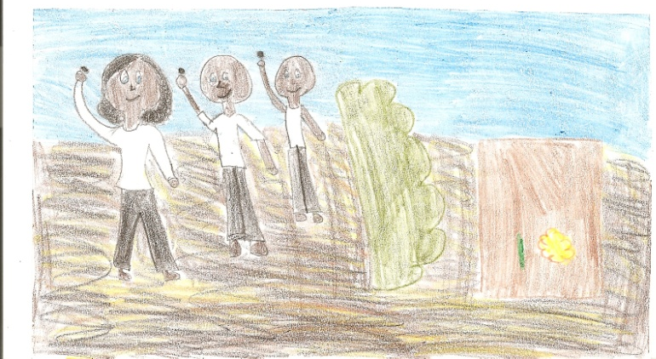
Shot seven
Description/Action: Shows the kids getting ready to throw rocks at Miss Lottie’s garden
Framing: Long Shot
Angle: Eye Level
Music/Sound: None
Dialogue/Narration: Whispering to throw the stones
Editing techniques: Dissolve
Camera Movements: Boom Crane
Lighting: High Key

Slide 9
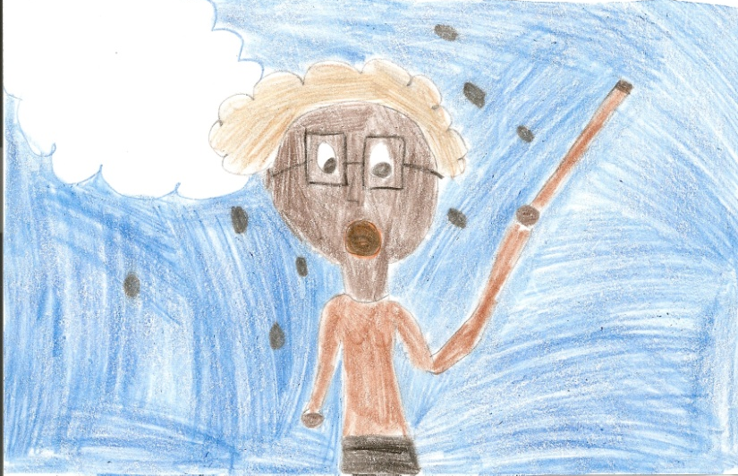
Shot eight
Description/Action: Showing Miss Lottie having stones thrown at her and her flowers
Framing: Medium Shot
Angle: Eye Level
Music/Sound: None
Dialogue/Narration: Yelling at the kids to get out of here
Editing techniques: Cut
Camera Movements: Zoom in on Miss Lottie
Lighting: High Key

Slide 10
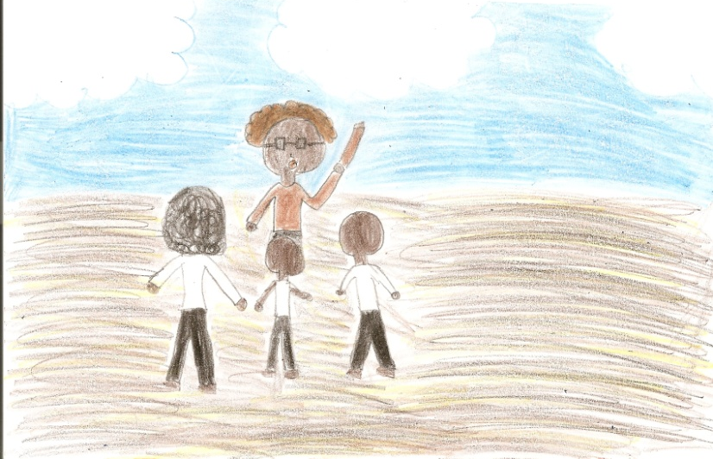
Shot nine
Description/Action: Kids dancing and chanting around Miss Lottie
Framing: Long Shot
Angle: Eye Level
Music/Sound: None
Dialogue/Narration: Kids chanting “Old witch, fell in a ditch, picked up a penny and thought she was rich!”
Editing techniques: Wipe
Camera Movements: Zoom
Lighting: High Key

Slide 11
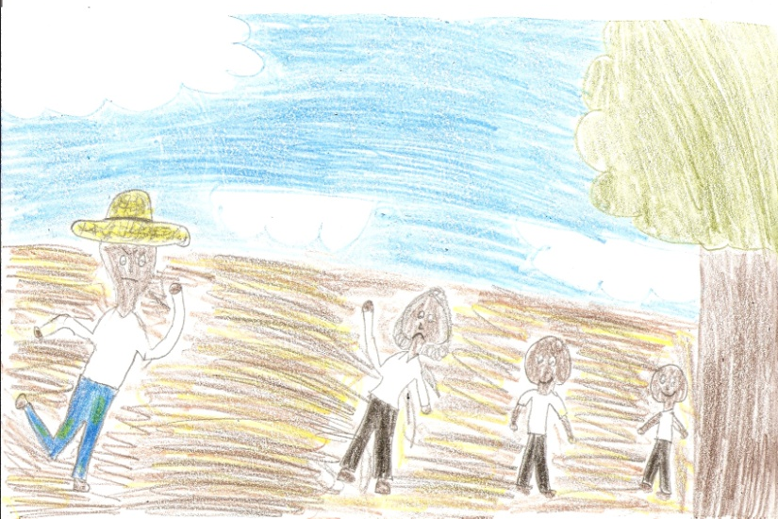
Shot ten
Description/Action: John Burke chasing after the kids
Framing: Long Shot
Angle: Eye Level
Music/Sound: Non- Diegetic; Fast/Suspenseful
Dialogue/Narration: Kids panting
Editing techniques: Cut
Camera Movements: Dolly Tracking
Lighting: High Key

