Slide 1
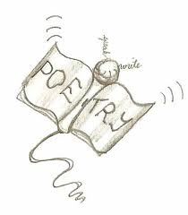
Hanging Fire
Fill out page 221-chart and Q1
Underline the refrain in this poem
Why is this line repeated?
What details lead up to this line that contribute to your analysis?
Mama’s in the bedroom with the door closed”
What does this line mean?

